Slide 1
Chapter 27
Object-Oriented DBMSs – Concepts and Design
Pearson Education © 2014

Slide 2

Chapter 27 - Objectives
The next generation of database systems.
Framework for an OO data model.
Main strategies for developing an OODBMS.
Issues underlying OODBMSs.
Advantages and disadvantages of OODBMSs.
Pearson Education © 2014

Slide 3

Next Generation Database Systems
First Generation DBMS: Network and Hierarchical
  Required complex programs for even simple queries.
  Minimal data independence.
  No widely accepted theoretical foundation.
Second Generation DBMS: Relational DBMS
  Helped overcome these problems.
Third Generation DBMS: OODBMS and ORDBMS.
Pearson Education © 2014

Slide 4
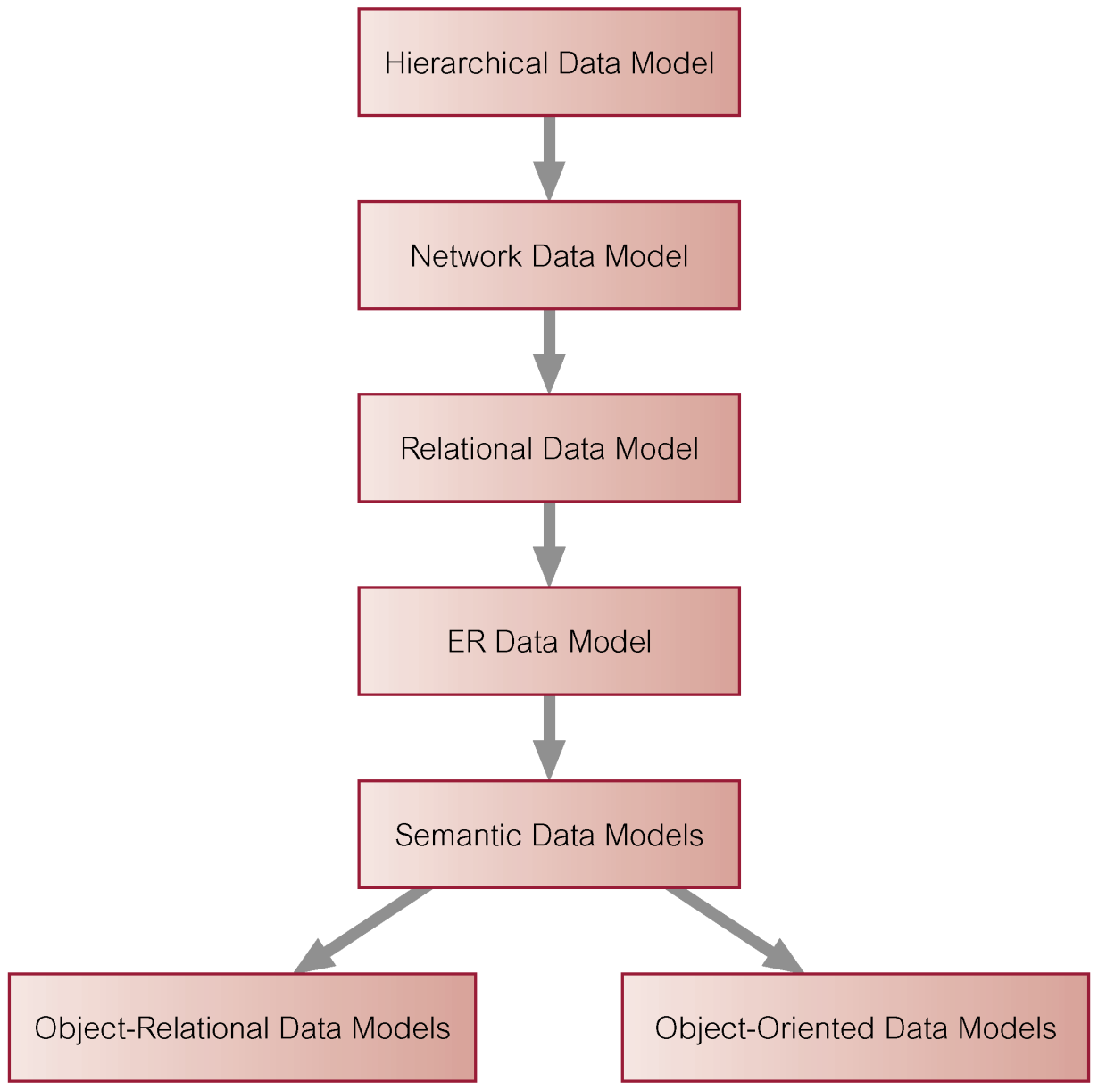
History of Data Models
Pearson Education © 2014

Slide 5
88 Object-Oriented Data Model
No one agreed object data model. One definition:
Object-Oriented Data Model (OODM)
  Data model that captures semantics of objects supported in object-oriented programming.
Object-Oriented Database (OODB)
  Persistent and sharable collection of objects defined by an OODM.
Object-Oriented DBMS (OODBMS)
  Manager of an OODB.
Pearson Education © 2014

Slide 6
Object-Oriented Data Model
Zdonik and Maier present a threshold model that an OODBMS must, at a minimum, satisfy:
  It must provide database functionality.
  It must support object identity.
  It must provide encapsulation.
  It must support objects with complex state.
Pearson Education © 2014

Slide 7
Object-Oriented Data Model – Different Definitions
Khoshafian and Abnous define OODBMS as:
  OO = ADTs + Inheritance + Object identity
  OODBMS = OO + Database capabilities.
Parsaye et al. gives:
  High-level query language with query optimization.
  Support for persistence, atomic transactions: concurrency and recovery control.
  Support for complex object storage, indexes, and access methods.
  OODBMS = OO system + (1), (2), and (3) just above.
  (No exact agreement of the OODM definition!)
Pearson Education © 2014

Slide 8
88 Commercial OODBMSs
GemStone/S from Gemstone Systems Inc.,
Objectivity/DB from Objectivity Inc.,
ObjectStore from Progress Software Corp.,
Versant Object Database db40 and FastObjects from Versant Corp.
Pearson Education © 2014

Slide 9
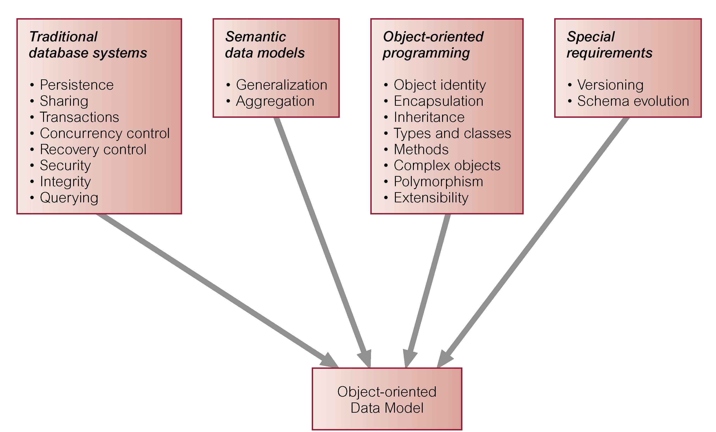
Origins of the Object-Oriented Data Model
Pearson Education © 2014

Slide 10
88 OODBMS
Eliminates impedance mismatch
Pearson Education © 2014

Slide 11
88 Alternative Strategies for Developing an OODBMS
Extend existing OO programming language.
  GemStone extended Smalltalk.
Provide extensible OODBMS library.
  Approach taken by Ontos, Versant, and ObjectStore.
Embed OODB language constructs in a conventional host language.
  Approach taken by O₂, which has extensions for C. (Teacher should research this.)
Pearson Education © 2014

Slide 12
88 Alternative Strategies for Developing an OODBMS
Extend existing database language with object-oriented capabilities.
  Approach being pursued by RDBMS and OODBMS vendors.
  Ontos and Versant provide a version of OSQL.
Develop a novel (brand new) database data model/language.
Pearson Education © 2014

Slide 13
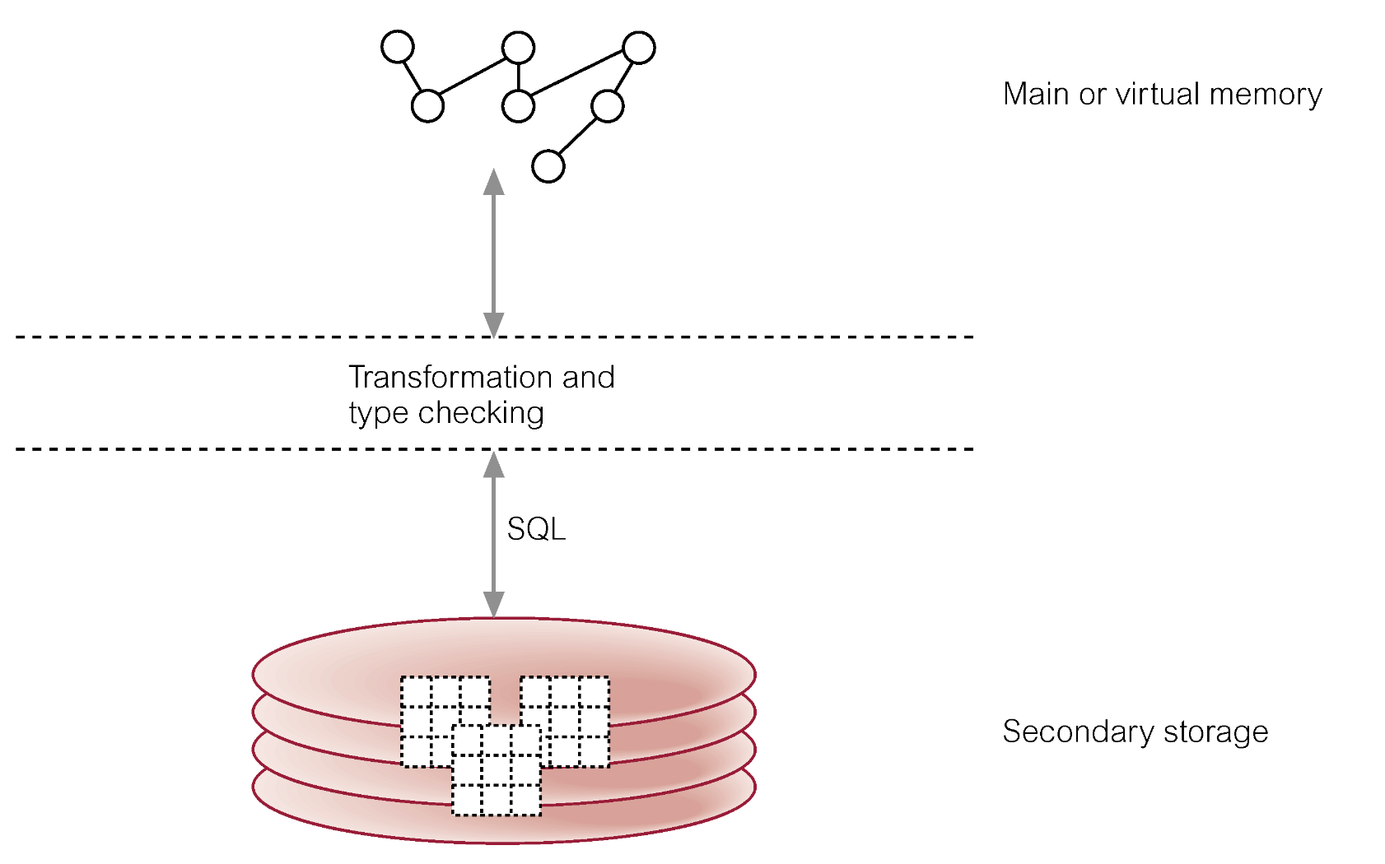
Two-Level Storage Model for RDBMS- Optional
Pearson Education © 2014

Slide 14
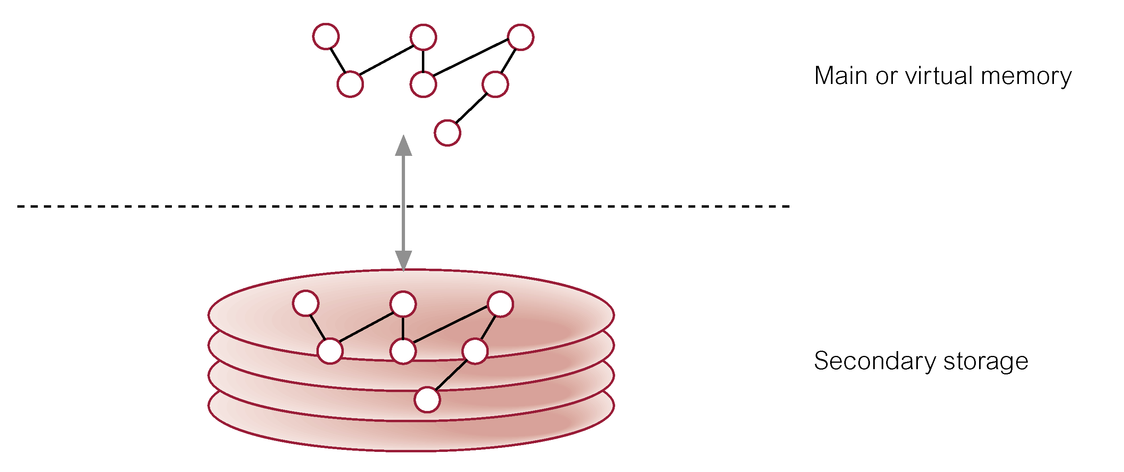
Single-Level Storage Model for OODBMS
(Optional)
Pearson Education © 2014

Slide 15
Pointer Swizzling Techniques
The action of converting object identifiers (OIDs) to main memory pointers.
Aim is to optimize access to objects.
Should be able to locate any referenced objects on secondary storage using their OIDs.
Once objects have been read into cache, want to record that objects are now in memory to prevent them from being retrieved again.
Pearson Education © 2014

Slide 16
Pointer Swizzling Techniques
Could hold lookup table that maps OIDs to memory pointers (e.g. using hashing).
Pointer swizzling attempts to provide a more efficient strategy by storing memory pointers in the place of referenced OIDs, and vice versa when the object is written back to disk.
Pearson Education © 2014

Slide 17
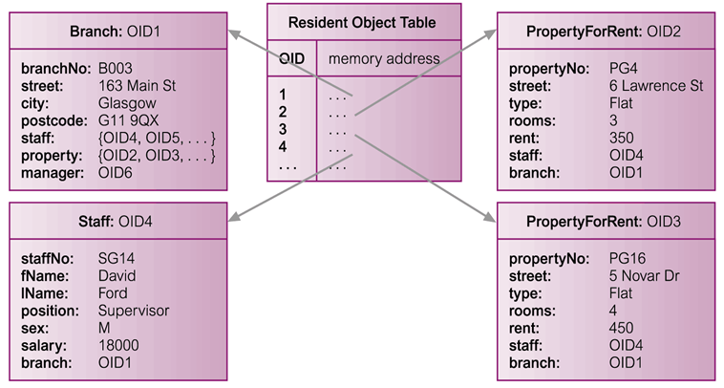

Resident Object Table (ROT) - Optional
Pearson Education © 2014

Slide 18
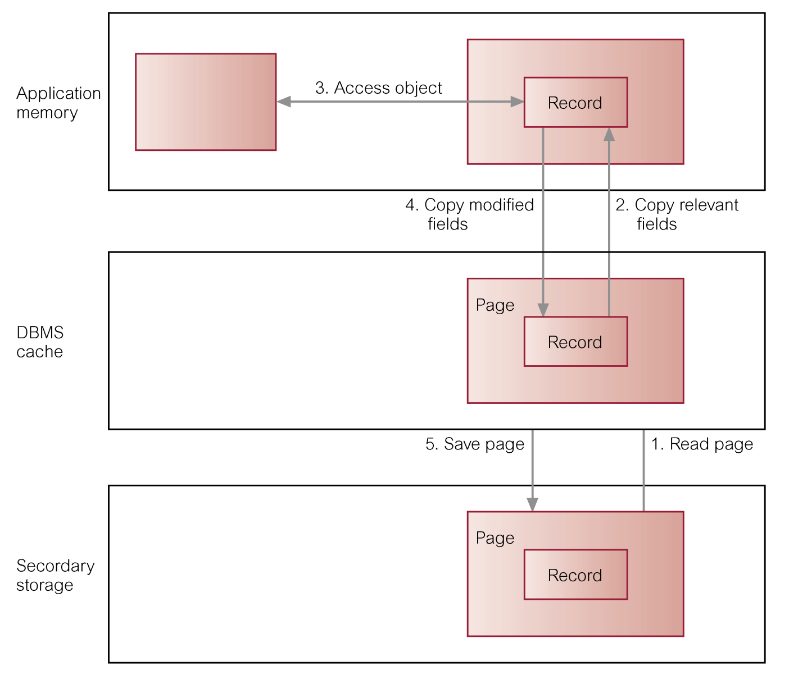
Accessing an Object with a RDBMS - Briefly
Pearson Education © 2014

Slide 19
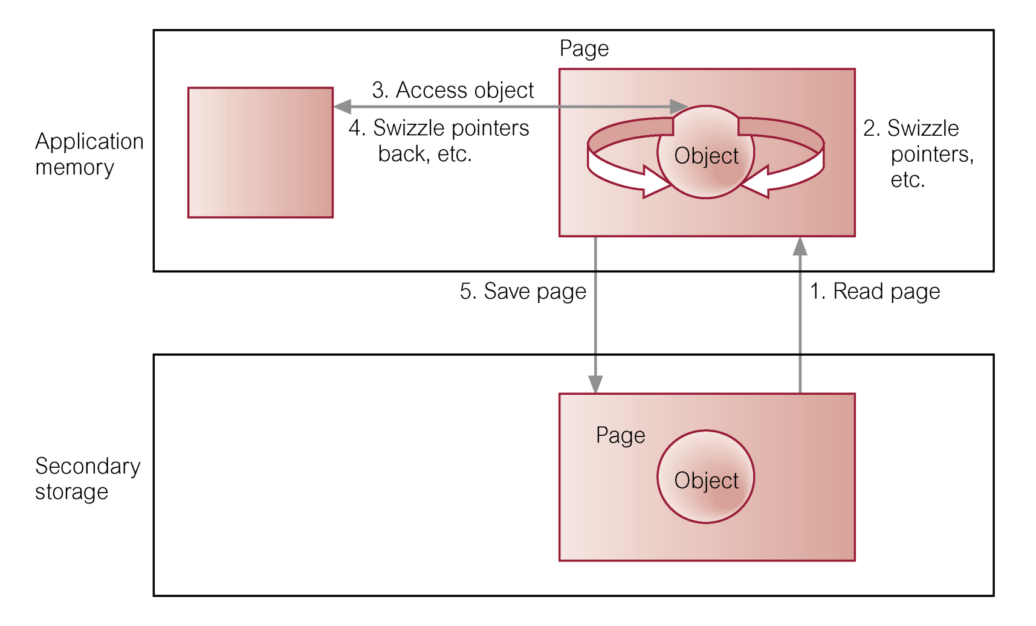
Accessing an Object with an OODBMS - Briefly
Pearson Education © 2014

Slide 20
Advantages of OODBMSs
Enriched Modeling Capabilities.
Extensibility.
Removal of Impedance Mismatch.
More Expressive Query Language.
Support for Schema Evolution.
Support for Long Duration Transactions.
Applicability to Advanced Database Applications.
Improved Performance.
Pearson Education © 2014

Slide 21
88 Disadvantages of OODBMSs
Lack of Universal Data Model.
Lack of Experience.
Lack of Standards.
Query Optimization compromises Encapsulation.
Object Level Locking may impact Performance.
Complexity.
Lack of Support for Views.
Lack of Support for Security.
Pearson Education © 2014

Slide 22
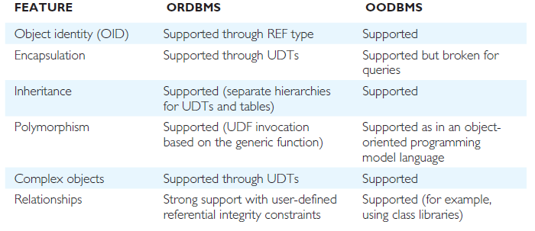
Comparison of ORDBMS and OODBMS – Data Modeling
Pearson Education © 2014

Slide 23
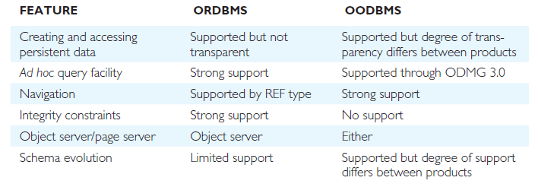
Comparison of ORDBMS and OODBMS – Data Access
Pearson Education © 2014

Slide 24
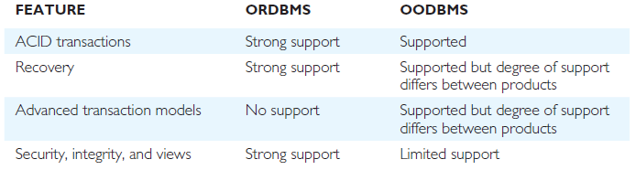
Comparison of ORDBMS and OODBMS – Data Sharing
Pearson Education © 2014

Slide 25
UML
Defined as “a standard language for specifying, constructing, visualizing, and documenting the artifacts of a software system”.
The UML does not prescribe any particular methodology, but instead is flexible and customizable to fit any approach and can be used in conjunction with a wide range of software lifecycles and development processes.
Pearson Education © 2014

Slide 26
Do the MainPoints, etc.
Then do the next slide.

Slide 27
This lesson is sometimes Extra Credit! Sometimes Not!

